Slide 1


Challenge #2 Refugee Crisis
The Islamic University of Gaza
Mohammed El-Agha, Abdullah Abu Nada, Ahmed Abu Amsha, Anas Alsalool
Masters in Information Technology, Data Science Track

Slide 2
First of All!

Slide 3


Slide 4
What is the Challenge?

Slide 5
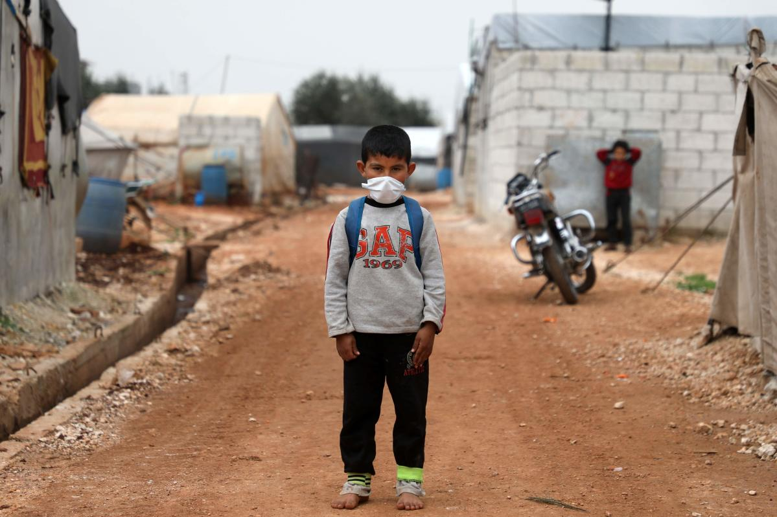

Slide 6


Slide 7





Data
fatalities
dist
terrain
forciby_displaced
geo

Slide 8
Data Exploration

Slide 9
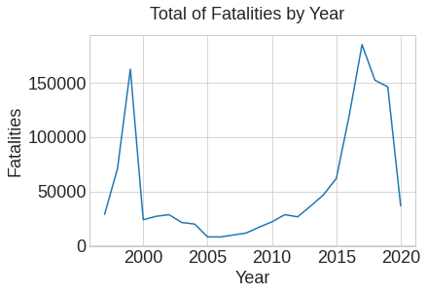
Fatalities
High rates at the end of the 1990s
Followed by a sharp decline
Then, relative stability for 11 years
Then a gradual rise until reaching the highest rates!

Slide 10
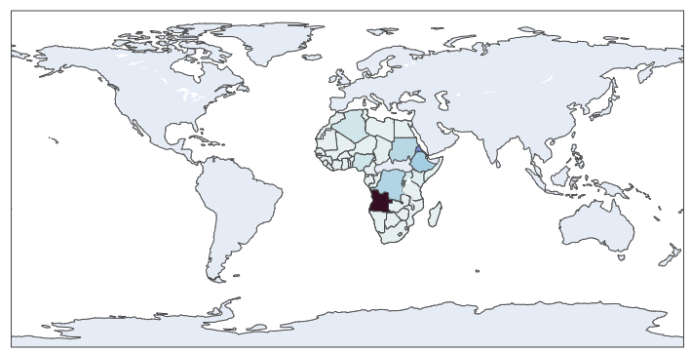
1991-2000 Fatalities
Top 5
Angola
Eritrea
Ethiopia
Congo
Sudan
Africa!

Slide 11
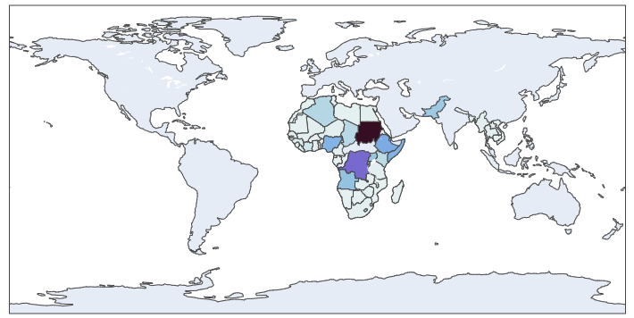
2001-2010 Fatalities
Top 5
Sudan
Congo
Ethiopia
Somalia
Nigeria
Africa!

Slide 12
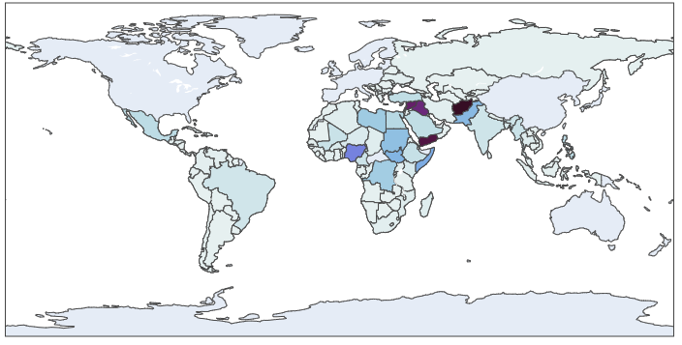
2011-2020 Fatalities
Top 5
Afghanistan
Yemen
Syria
Iraq
Nigeria
Arab Spring!
Wars!

Slide 13
1990-2000-2010-2020 Fatalities

Slide 14
Displaced
FIT (displaced abroad)
IDP (displaced internally)
ASY (asylum seekers awaiting decision)

Slide 15
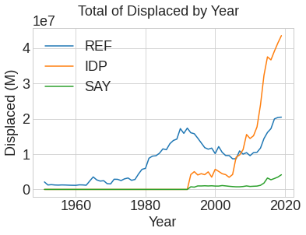
Displaced
high rates of fatalities -> increased rates of refugees

Slide 16
Data Modeling & Results (Syria as a sample)

Slide 17
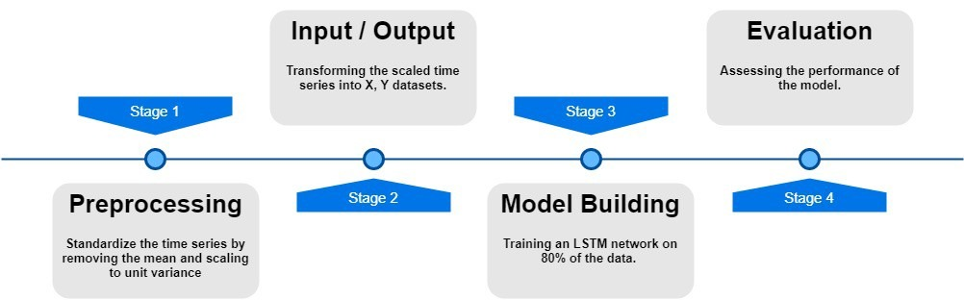

Slide 18
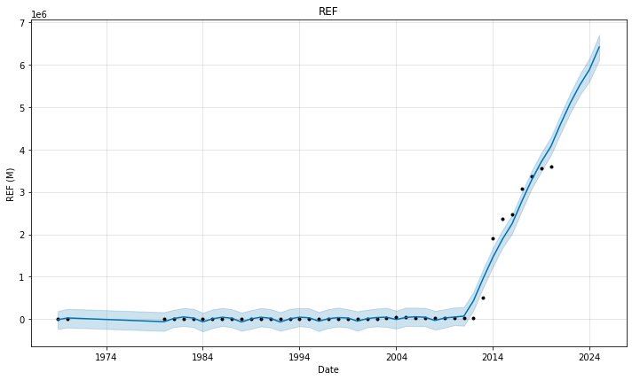
FIT (displaced abroad)
History
Prediction

Slide 19
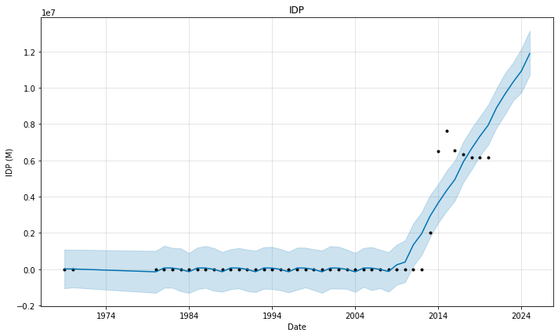
IDP (displaced internally)
History
Prediction

Slide 20
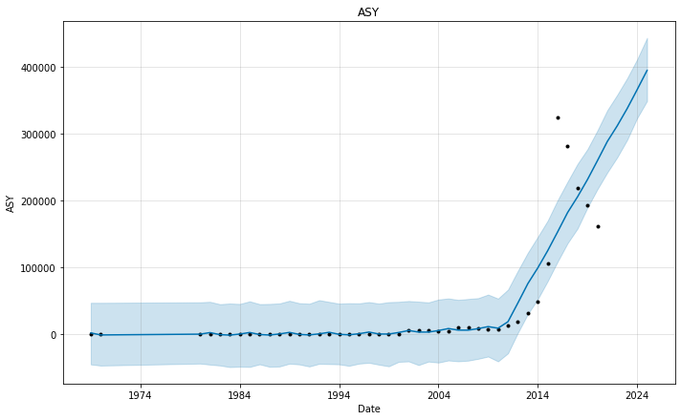
ASY (asylum seekers awaiting decision)
History
Prediction

Slide 21
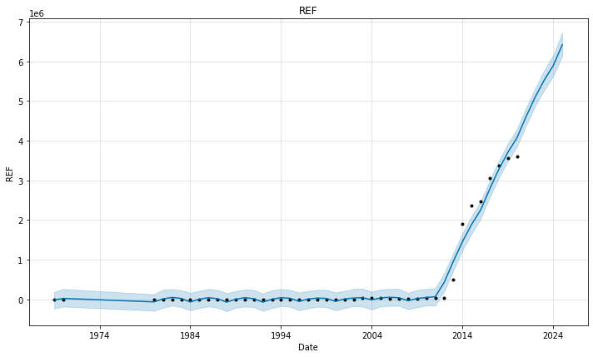
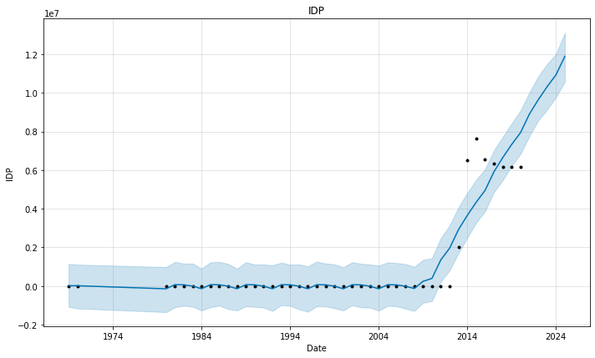
A sharp increase in the rates of migration and displacement with the beginning of 2010-2011, the year of the beginning of the Syrian war
The rates of displacement are expected to continue to increase, especially as the war continues

Slide 22
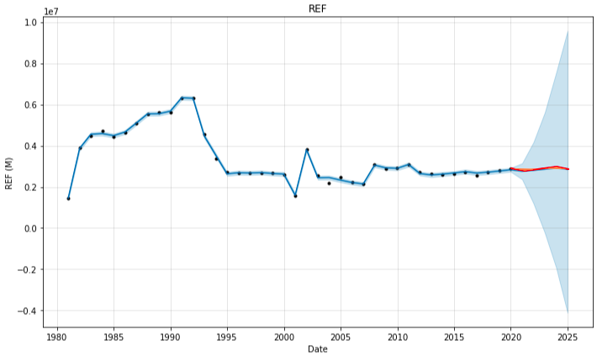
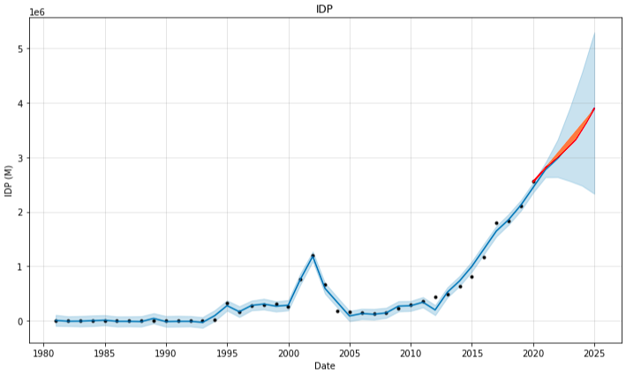
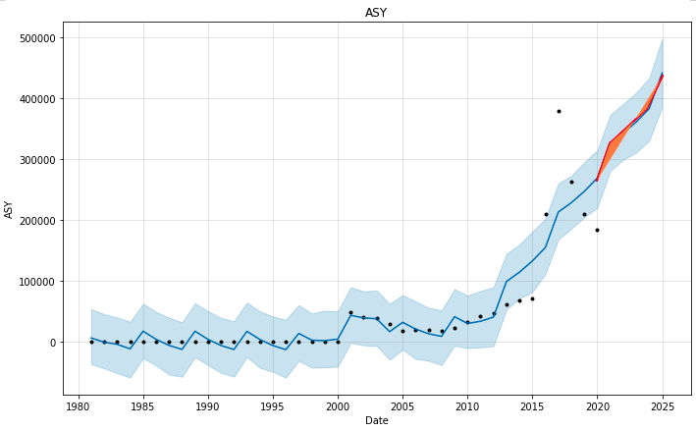
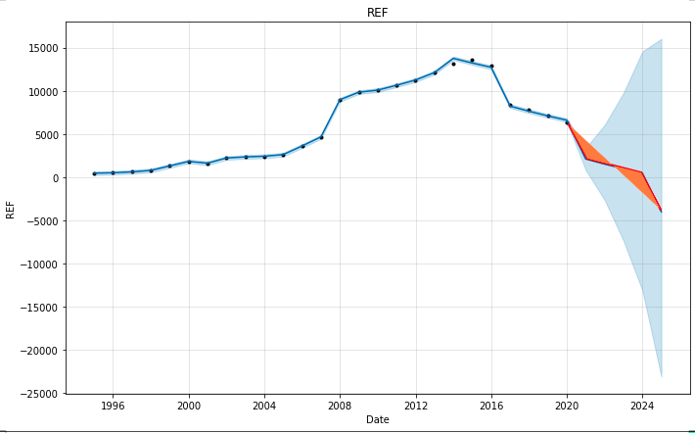
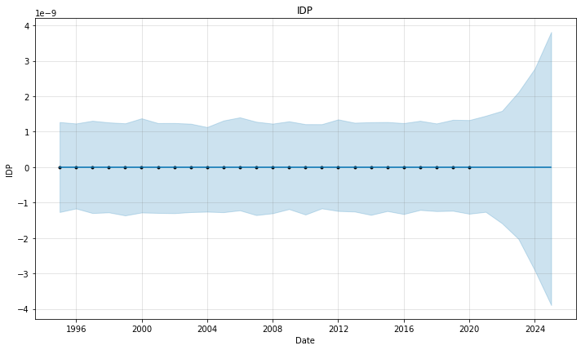
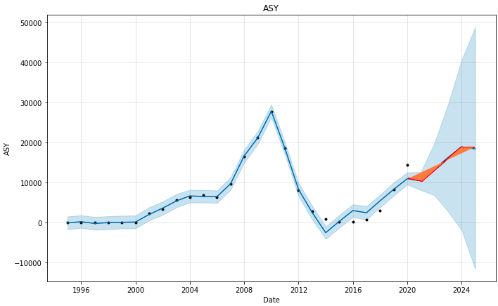
Afghanistan
Mexico

Slide 23
After Finished!

Slide 24
Conclusion
Progression in fatalities global rates
Progression in reugees rates
Last 10 years have the highest rates
Arab spring has a high credit in this increased rates

Slide 25
Lessons learnt by doing this exercise as a team
Big problem becomes small problems!
Teamwork is work
More productivity
More enjoy in work!
The team isn’t working if the team isn’t working

Slide 26
References
Data Hackathon details and datasets
https://github.com/UN-ICC/ICC-Data-Hackathon-2021
Our work
https://github.com/MohammedElagha/FIT-2021-IUG

